Slide 1
ANALYSIS OF EMG SIGNAL
GUIDED BY
-ASHOK PALANIYAPPAN

Slide 2
DONE BY
-LAKSHMI PRIYA K T
119011014
-MONISHA GOWRI
119011021

Slide 3
EMG [ELECTROMYOGRAPHY]
EMG is an electro-diagnostic medical technique for evaluating and recording the electrical activity produced by the skeletal muscles.
EMG is performed using an instrument called electromyography to produce a record called electromyogram.
An electromyography detects the electrical potential generated by the muscle cells when they are electrically or neurologically activated.

Slide 4
USES:
To diagnosis-Neuromuscular disease.
Kinesiology-study the mechanics of body movements.
Control signal for prosthetic devices.
Used to measure the conducting function of the nerves

Slide 5
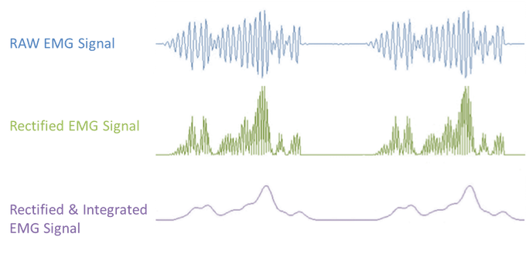
RAW AND FILTERED EMG SIGNALS

Slide 6
PSEUDOCODE:
STEP 1:To import necessary packages for python EMG simulation.
STEP 2:To generate Bust signals using np.random.uniform() function.
STEP 3:To generate Quiet signal using np.random.uniform() function.
STEP 4:Using np.concatenate() functions, these Burst and Quiet signals are combined to get EMG signal.
STEP 5:Using np.array() function, the EMG signal is sampled at a given rate.
STEP 6:Using Plot() function, the EMG signal is plotted.
STEP 7:In filtering phase, Creating a function filtereemg() that takes inputs such as time, emg, sfreq, high_band, low_band.
STEP 8:Using this parameters, the normalized cutoff frequencies are calculated.
STEP 9:Using Butter() function to filter the EMG signal using a band pass filter design.
STEP 10:Using filtfilt() function the filtered signal is processed and is rectified using abs() function.
STEP 11:This filtered signal is then plotted using Plot() and Subplot() function.

Slide 7
CODE:
import matplotlib.pyplot as plt
#simulate EMG signal
burst1 = np.random.uniform(-1, 1, size=1000) + 0.08
burst2 = np.random.uniform(-1, 1, size=1000) + 0.08
quiet = np.random.uniform(-0.05, 0.05, size=500) + 0.08
emg = np.concatenate([quiet, burst1, quiet, burst2, quiet])
time = np.array([i/1000 for i in range(0, len(emg), 1)]) # sampling rate 1000 Hz
# plot EMG signal
fig = plt.figure()
plt.plot(time, emg)
plt.xlabel('Time (sec)')
plt.ylabel('EMG (a.u.)')
fig_name = 'fig2.png'
fig.set_size_inches(w=11,h=7)
fig.savefig(fig_name)

Slide 8
# process EMG signal: remove mean
emg_correctmean = emg - np.mean(emg)
# plot comparison of EMG with offset vs mean-corrected values
fig = plt.figure()
plt.subplot(1, 2, 1)
plt.subplot(1, 2, 1).set_title('Mean offset present') plt.plot(time, emg)
plt.locator_params(axis='x', nbins=4) plt.locator_params(axis='y', nbins=4)
plt.ylim(-1.5, 1.5)
plt.xlabel('Time (sec)')
plt.ylabel('EMG (a.u.)')
plt.subplot(1, 2, 2) plt.subplot(1, 2, 2).set_title('Mean-corrected values')
plt.plot(time, emg_correctmean)
plt.locator_params(axis='x', nbins=4) plt.locator_params(axis='y', nbins=4)
plt.ylim(-1.5, 1.5)
plt.xlabel('Time (sec)‘)
plt.ylabel('EMG (a.u.)')
fig.tight_layout()
fig_name = 'fig2.png‘
fig.set_size_inches(w=11,h=7)
fig.savefig(fig_name)

Slide 9
import scipy as sp
from scipy import signal
# create bandpass filter for EMG
high = 20/(1000/2) low = 450/(1000/2) b, a = sp.signal.butter(4, [high,low], btype='bandpass')
# process EMG signal: filter EMG
emg_filtered = sp.signal.filtfilt(b, a, emg_correctmean)
# plot comparison of unfiltered vs filtered mean-corrected EMG
fig = plt.figure()
plt.subplot(1, 2, 1)
plt.subplot(1, 2, 1).set_title('Unfiltered EMG')
plt.plot(time, emg_correctmean)
plt.locator_params(axis='x', nbins=4)
plt.locator_params(axis='y', nbins=4)
plt.ylim(-1.5, 1.5)
plt.xlabel('Time (sec)')
plt.ylabel('EMG (a.u.)')
plt.subplot(1, 2, 2)
plt.subplot(1, 2, 2).set_title('Filtered EMG')
plt.plot(time, emg_filtered)
plt.locator_params(axis='x', nbins=4)
plt.locator_params(axis='y', nbins=4) plt.ylim(-1.5, 1.5) plt.xlabel('Time (sec)') plt.ylabel('EMG (a.u.)') fig.tight_layout() fig_name = 'fig3.png' fig.set_size_inches(w=11,h=7) fig.savefig(fig_name

Slide 10
THANK YOU

